Slide 2

Is Being A Christian Worthwhile?
Isaiah 1:18-20

Slide 3
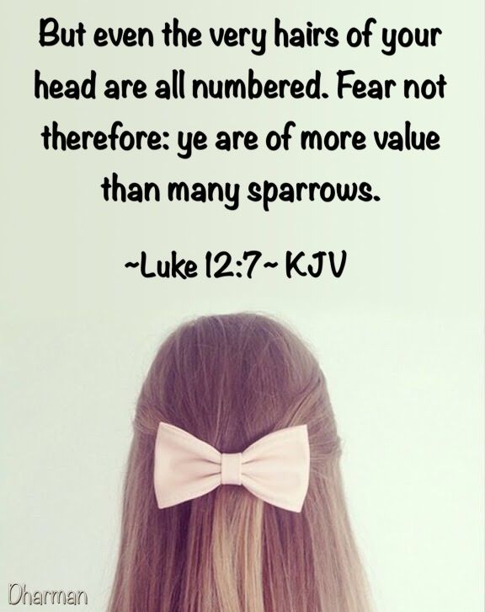
FIRST PLEA
“You are an Eternal and Infinite God. You inhabit the universe. I did not feel you would be interested in my sins, much less forgive them.”
“I have great interest in you, have furnished you all things needed — the very hairs of your head are numbered.” (Matthew 10:30 NKJV 30 "But the very hairs of your head are all numbered.”)

Slide 4

SECOND PLEA
“My sins are so great and so many — I doubt you could forgive me.”
“I have provided for the uttermost sin through the death of My Son who has become author of salvation to all them that obey Him” (Hebrews 5:9 NKJV 9 And having been perfected, He became the author of eternal salvation to all who obey Him,).

Slide 5

THIRD PLEA
“But my sins are not just acts of willfulness and of rebellion. Actually, they are habits of my life. Furthermore, I love them much. I do not want to give them up and I can never find strength to do so.”
“my grace is sufficient for you.” (2 Corinthians 12:9 NKJV 9 And He said to me, "My grace is sufficient for you, for My strength is made perfect in weakness." Therefore most gladly I will rather boast in my infirmities, that the power of Christ may rest upon me.”)

Slide 6
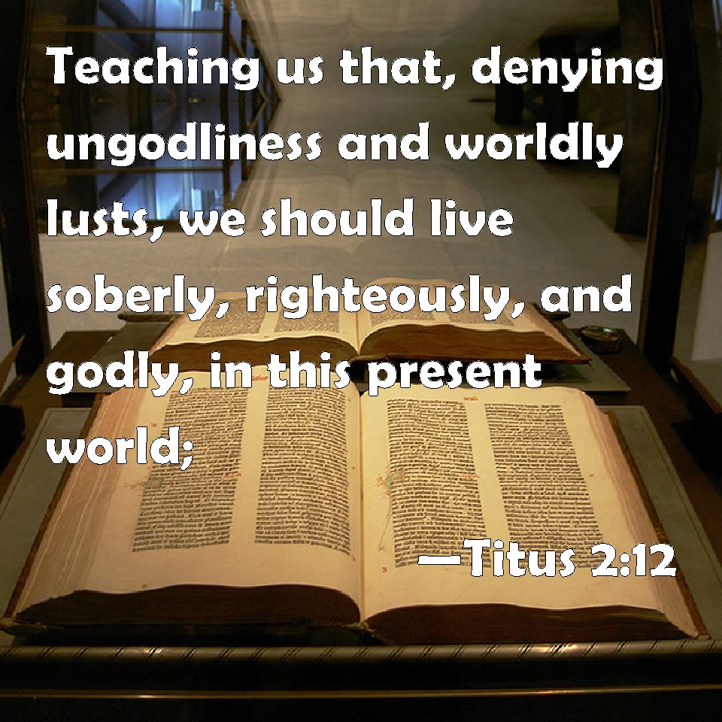
FOURTH PLEA
“Frankly, Lord, I just cannot decide if it is really worth it.”
A completely HONEST ANSWER of many in this world!
Even IN THE CHURCH!
Worldliness is opposed to Godliness, and we are not prone to give it up!
WHY?
Because we have not learned if it is REALLY WORTH IT OR NOT!

Slide 7

TO CHRISTIANS
Haggai 1:1,2 “The time has not come, the time that the Lord’s house should be built.”
People Should Count The Cost – suggests the need of reasoning
Worth of Present Life – 1 Timothy 6:7

Slide 8
TO CHRISTIANS
What Will The Change Cost Me?
LIFE- Matthew 10:39
FORSAKING ALL – Luke 14:26
SELF DENIAL – Matthew 16:24; Luke 9:23
PERSECUTION - 2 Timothy 3:12; John 16:2
SACRIFICE – Romans 12:1
WORK – Galatians 6:9,10
SUFFERING – 2 Timothy 2:10
SEEKING FIRST THE KINGDOM- Matthew 6:33
TEACHING- 2 Timothy 2:2; Hebrews 5:12
LIFE OF GROWTH- 1 Peter 2:1,2

Slide 9

WHAT GAIN WILL I REALIZE?
ALL MATERIAL NEEDS – Matthew 6:33
ALL SPIRITUAL BLESSINGS – Ephesians 1:3
PRIVILEGE OF PRAYER- John 15:7; Colossians 3:17
PRIVILEGE OF WALKING A NEW LIFE – 2 Corinthians 5:17
INCORRUPTIBLE INHERITANCE- 1 Peter 1:3,4
PEACE THAT PASSES ALL UNDERSTANDING- Revelation 14:13; Philippians 4:7; John 14:27
NOTHING OF VALUE IS LEFT OUT!
Nothing that is profitable that is not realized in Christ.

Slide 10
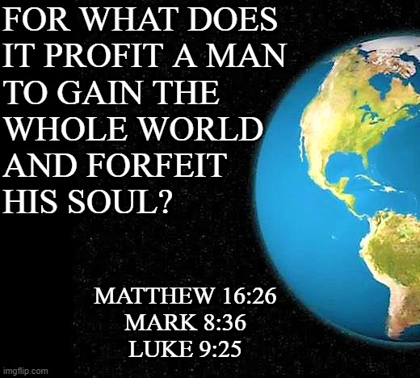
WHAT GAIN WILL I REALIZE?
NO Interest in this life or the life to come that godliness does not promote – 1 Timothy 4:8
It has the PROMISE of the “life that now is”
It has the PROMISE of the life “which is to come”
Being A Christian is the ONLY THING that can promise ETERNAL LIFE! 1 John 5:11
IS IT WORTH IT?
Jesus said: “gain the whole world – lose your soul”
YOU ARE THE GRAND LOSER!

Slide 11
Is It Worth It To You?

